Slide 1
Shell Bootcamp 2024 3 Reflections for Week 4
Jallipalli Lakshmi Susmitha Jayasri
Date : 20-Sep-2024

Slide 2

About Me
“I am not a person who just completes the task, I enjoy the process and grow through it”
Please share an image / visual that best represents you

Slide 3

My learnings from this week!

Slide 4
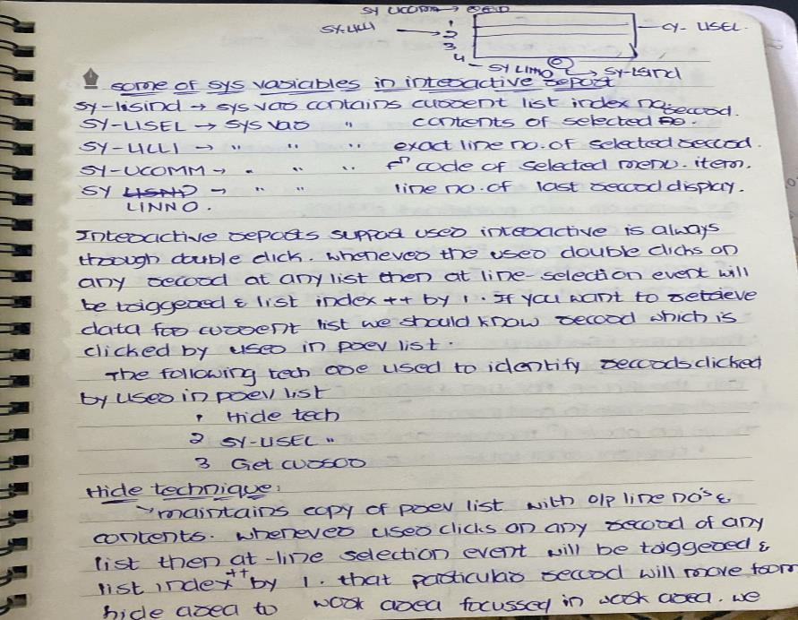
Learning 1 | My takeaways
Key Learnings: I have learned how to create interactive report and what exactly are interactive and different events that can be triggered during them.
Key takeaways: Interactive reports are the ones that display basic information in main list and extra information will be displayed in the secondary lists. There can be up to 20 secondary lists for a main list.
Interactive reports from SAP can help Shell by providing real-time data access and enhanced data visualization, making it easier to understand complex data These reports are customizable to meet specific needs and can integrate with other systems for seamless information flow.
[Add a graphic that provides evidence of what you learned]

Slide 5
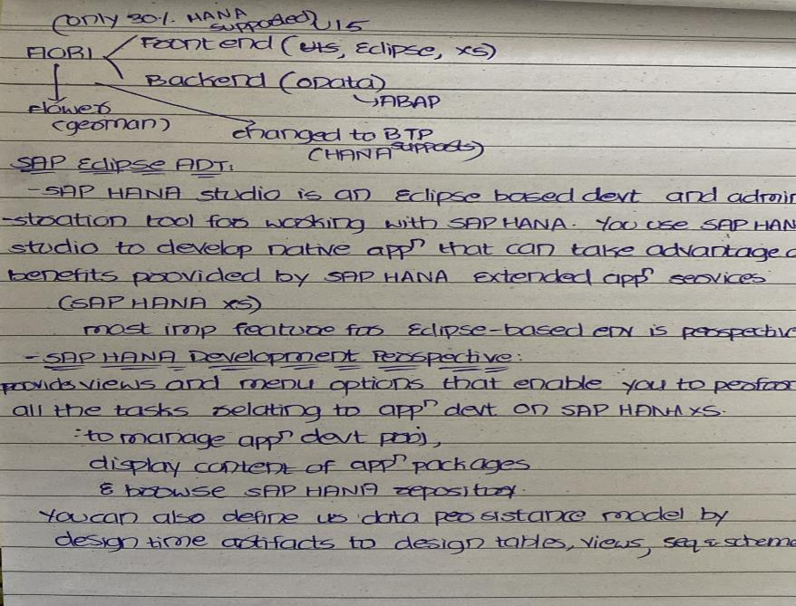
Learning 2 | My takeaways
Key learnings: I have learned how SAP HANA works and what is SAP HANA and also features of HANA and how it is in memory Database.
Key takeaways: SAP HANA is hybrid in memory database. It uses combined row and column storage and object oriented based technology. It wastes no time in fetching data because it uses in memory database.
Shell uses SAP HANA to integrate real-time data from various sources, improving monitoring and decision-making. It enhances performance by speeding up analytics and supports financial management through SAP S/4HANA Central Finance.
[Add a graphic that provides evidence of what you learned]

Slide 6
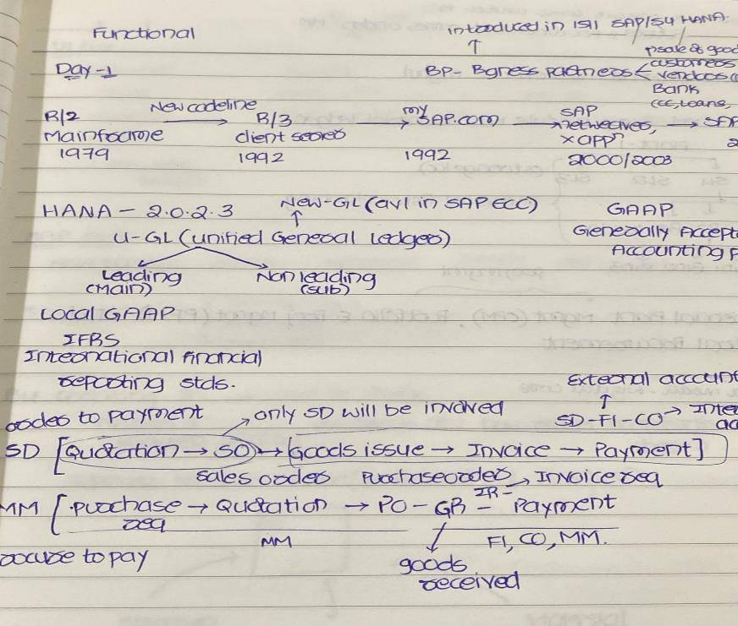
Learning 3 | My takeaways
Key learnings: I have learned functional modules of SAP which are Sales and Distribution, Material Management, Controlling, Product Planning, Extended Warehouse management, HR and so..on
Key Takeaways: SD manages sales processes, customer orders, and distribution of goods. MM handles procurement, inventory management, and material requirements planning. PP oversees production processes, scheduling, and manufacturing operations. EWM optimizes warehouse operations, including inventory tracking and storage management.
Shell uses SD to manage customer orders and distribution, MM for procurement and inventory management, PP to streamline production processes, and EWM to optimize warehouse operations and inventory tracking
[Add a graphic that provides evidence of what you learned]

Slide 7

Relevance of learnings for my organization

Slide 8

Learning 1 | Relevance for Shell
Interactive reports in SAP, especially in SAP ABAP, offer dynamic data interaction. They allow users to drill down into specific data points for detailed analysis and are event-driven, responding to user actions like clicks.
These reports can generate multiple lists, providing layered views of data, and support user commands for easy navigation. They are highly customizable, ensuring that users see the most relevant information for their needs. This makes them invaluable for businesses like Shell, enhancing data visualization, decision-making, and collaboration.
[Add a graphic that provides view of how Shell implements this learning]

Slide 9

Learning 2 | Relevance for Shell
SAP HANA is highly relevant for Shell due to its ability to handle large volumes of data and provide real-time analytics. It integrates data from various sources, including real-time sensor data from wells and reservoirs, enhancing monitoring and decision-making.
The platform accelerates business processes, allowing Shell to generate reports and insights quickly. Additionally, SAP HANA supports financial management through SAP S/4HANA Central Finance, helping Shell streamline its financial operations. Overall, it plays a crucial role in Shell’s digital transformation efforts, simplifying and aligning its diverse ERP systems.
[Add a graphic that provides view of how Shell implements this learning]

Slide 10
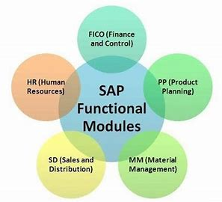
Learning 3 | Relevance for Shell
Shell uses the SD module to efficiently manage sales processes and distribution networks, ensuring timely delivery to customers. The MM module is crucial for procurement and inventory management, maintaining optimal inventory levels. PP helps streamline production processes, aligning manufacturing with demand. EWM optimizes warehouse operations, including accurate inventory tracking and storage management.
These modules collectively enable Shell to maintain seamless and efficient operations from procurement to production to distribution.
[Add a graphic that provides view of how Shell implements this learning]

Slide 11

Challenges in implementing learning

Slide 12
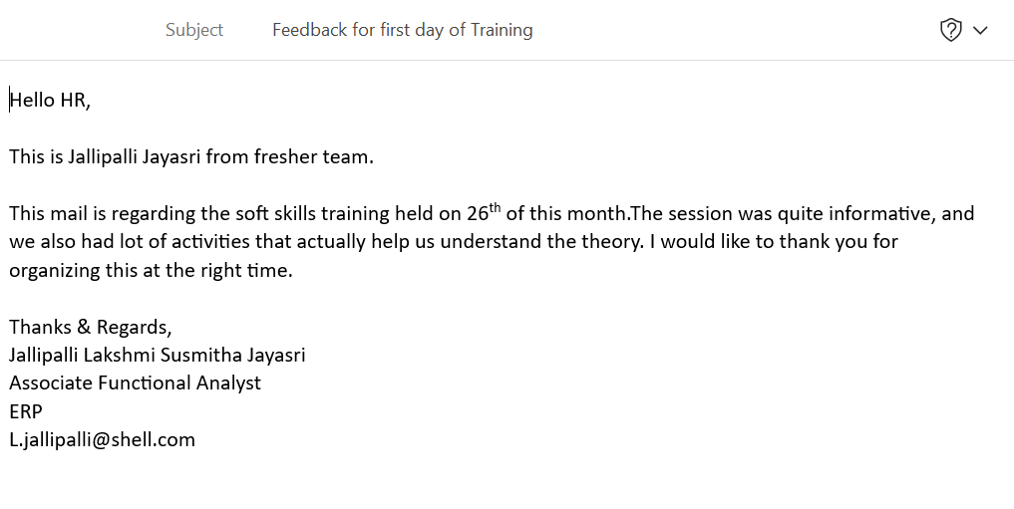
Challenge faced while implementing Learning 1
Challenge: Creating interactive reports involves lot of events and system variables which was bit difficult to keep track of.
Plan: Created several reports which made me comfortable with creating those reports.

Slide 13
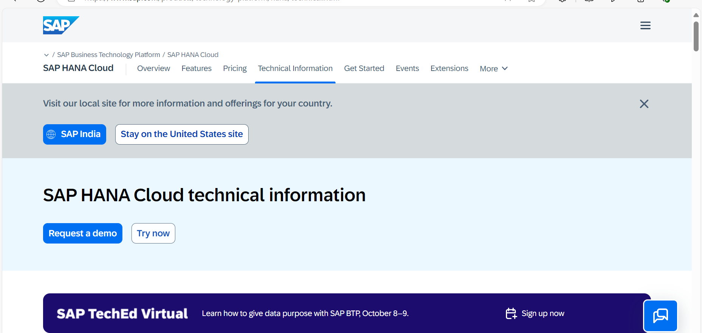
Challenge faced while implementing Learning 2
Challenge: SAP HANA involves a lot of technical jargon and concepts that can be overwhelming at first.
Plan: I started reading documentation of SAP HANA to be more familiar and clear with the concepts.
[Add a graphic that provides evidence of what you did to overcome this challenge]

Slide 14
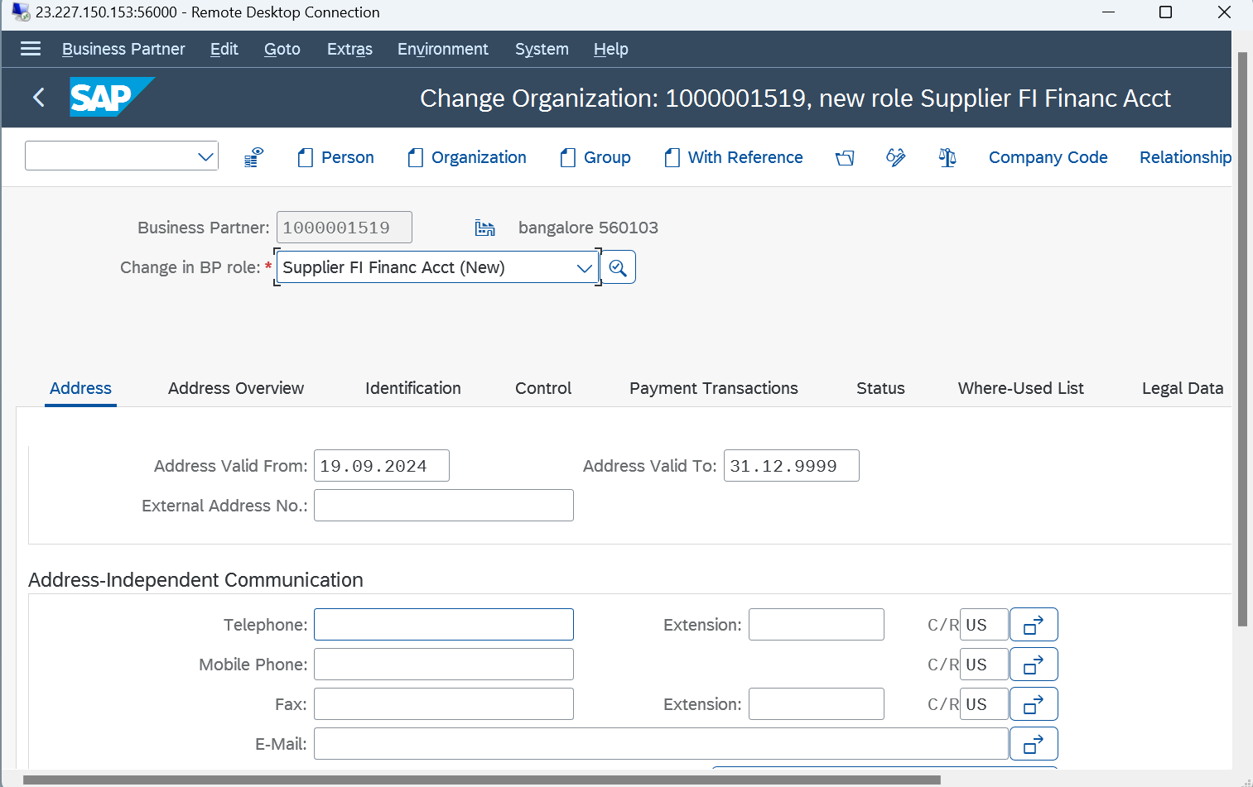
Challenge faced while implementing Learning 3
Challenge: Using navigation instead of transaction codes has been bit difficult.
Plan: Use navigation more frequently when to get more familiar with it.
[Add a graphic that provides evidence of what you did to overcome this challenge]

Slide 15

Action Plan

Slide 16
My Action Plan for this Week
Actions
Timeline
Status
Master the concepts of SAP and S4 HANA and BTP and functional modules of SAP
Read SAP documentation on SAP HANA
Use Navigation more than T code
Do ABAP programs by the end of week
Read SAP documentation on SAP HANA by end of week
Completed

Slide 17

Learning is also Fun!

Slide 18

Learning is also Fun!
My facilitator for ERP Technical Mr Mir Moheeb Ali has been very great teacher and made sessions very interactive and fun. He made all the sessions hands on.
So it has been very easy to understand since everything was practical.
[Add a graphic or a picture of how you/your team enjoyed the new learning]

Slide 19

Summary
Quick Summary:
SAP HANA is a combination of HANA database and data modelling and HANA administration and data provisioning in a single use.
Importance of topics in upcoming week:
Next week topic is functional modules of SAP
It provides a comprehensive understanding of business processes, enabling you to see the bigger picture and how different functions interconnect.
Connectivity of topics from current week:
In SAP S/4HANA, functional modules are integrated with technical components to ensure seamless data flow and efficient business operations.

Slide 20
Thank You

